Slide 1
Erasmus+
Erasmus Mundus Joint Masters (EMJM)
Erasmus Mundus Design Measures (EMDM)
European Education and Culture Executive Agency

Slide 2
Erasmus Mundus 2021-2027
Erasmus Mundus Action
EMJM
EMDM
Erasmus Mundus Joint Masters
Erasmus Mundus Design Measures

Slide 3
Erasmus+ Programme 2021-2027
New programme 2021-2027
KA1
Learning Mobility for Individuals
KA2
Cooperation for Innovation & Good practices
KA3
Support for Policy reform
EMJMD
Erasmus Mundus Action
Notes:
Increased focus on institutional cooperation
More internationalisation opportunities
Simplification and more flexibility
Increased impact of the EMJM scheme
More attractiveness and excellence
More sustainability
More inclusiveness

Slide 4
EMJM in brief…
A high-level integrated & transnational study programme at MA level
A Master programme of excellence open to all disciplines
Delivered by an international consortium of HEIs from different countries worldwide & other educational and/or non educational partners
Offering high-level scholarships to excellent students worldwide

Slide 5
EMJM – main requirements (1)
a jointly designed fully integrated curriculum and common implementation procedures based on the Standards for Quality Assurance of Joint Programmes in the EHEA (e.g. joint selection, promotion, common services, joint administrative and financial management, etc.)
be delivered by a consortium of at least three HEIs from three different countries of which at least two must be EU Member States and third countries associated to the Programme
international outreach to attract and enrol excellent students worldwide (part of which may benefit from an EMJM scholarship)

Slide 6
EMJM – main requirements (2)
compulsory physical mobility for all enrolled students – at least 2 study periods in two countries with a minimum duration of one academic semester each (different from the country of residence of students)
contribution of scholars/guest lecturers to teaching, training and research activities
delivery of a joint degree or multiple degrees (joint degrees are highly recommended where national legislation allows it)
At application stage EMJM proposals must present fully developed joint study programmes, ready to run and to be advertised worldwide after their selection.

Slide 7
EMJM Set-up
Fixed Grant Agreement of 74 months independently from the length of the master
Commitment to enrol a certain number of students per project
At least 4 master editions lasting 1 to 2 academic years (60, 90 or 120 ECTS)
Start of the 1st edition no later than the academic year following the year of project selection
At least 2 study periods in 2 countries (of which at least one in an EU Member State or a third country associated to the Programme and both different from the country of residence of students)
Geographical balance of students: no more than 10% of total scholarships per project awarded to students of the same nationality (does not apply to additional scholarships for targeted regions)

Slide 8
Taking part as an Organisation
Applicants (coordinator and full partners) must be legal entities: HEIs established in an EU Member State, third country associated to the Programme or an eligible third country not associated to the Programme
Association or organisation of HEIs, public or private organisations established in an EU Member State, third country associated to the Programme or eligible third country not associated to the Programme may also participate but not as coordinator
HEIs in EU Member States and third countries associated to the Programme: valid ECHE
HEIs in third countries not associated to the Programme: should commit to ECHE principles in the Partnership Agreement
HEIs from EU Member States, third countries associated to the Programme and third countries not associated to the Programme: completed accreditation/evaluation of the master programme
Minimum consortium: 3 HEIs from 3 different countries of which at least 2 must be an EU Member State or third country associated to the Programme + optional Other full academic or non-academic partners
Associated partners

Slide 9
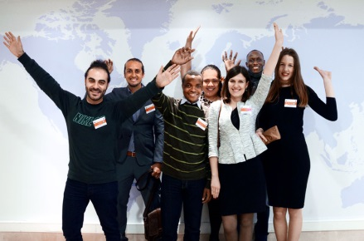
Taking part as an individual
Open to students worldwide
Applicants:
must hold a first higher education degree or equivalent
must not have benefited previously from an EMJM scholarship
The best ones can benefit from a scholarship depending on the number of scholarships available
Students apply directly to the EMJM consortium Catalogue with ongoing EMJMs offering scholarships: https://ec.europa.eu/erasmus-mundus

Slide 10
EMJM FUNDING RULES
1 simplified EU GRANT
EMJM
2 main targets
HEIs
Students
3 components
=
3 unit cost
Institutional
cost
Individual
needs
Scholarships

Slide 11
Institutional costs
Implementation costs of the study programme
unit cost per enrolled student of 750€ /month How to calculate: € 750 x n° of months x n° of enrolled students (cap of 100 enrolled students – but consortia are welcome to commit for higher numbers) => max. amount per project: 1.800.000 €
Same unit cost for scholarship holders and non-scholarship holders
Same unit cost for students from EU Member States, third countries associated to the Programme and third countries not associated to the Programme

Slide 12
Student scholarship
At student level:
Full Scholarship to cover subsistence, installation and travel + fee waiver
A single unit cost per scholarship holder How to calculate: € 1400 x number of months (min. 1 academic year - max. 24 months) => max. amount per student: 33 600 Euros
At project level:
How to calculate: € 1400 x number of months x number of students (cap of 60 students per EMJM project) => max. amount per project: 2,016,000 Euros per grant
=> Same unit cost for students from EU Member States, third countries associated to the Programme and third countries not associated to the Programme

Slide 13
Individual needs
At student level:
Contribution based on individual needs of students: 10 different unit costs varying between € 3.000 – € 60.000 => if below € 3000: to be covered by institutional costs
At project level:
Awarded at contracting stage: 0, 1 or 2 units costs of € 60 000 => max. amount per project: € 120 000
=> For all enrolled students (scholarship holders and non-scholarship holders)

Slide 14
Additional funds (for students from 9 target regions)
Response to the EU External priorities -> EU financial Instruments IPA III and NDICI for students from third countries not associated to the Programme
Contribution for additional scholarships (including the corresponding institutional costs) for the entire duration of the EMJM programme: 4 under IPA III and 31 under NDICI
=> max. amount provided: 1,806,000 Euros per grant

Slide 15
What is NEW ?
EMJM vs EMJMD - main messages
Simplification of funding mechanism:
Only 3 types of unit costs
Previous costs for travel and/ or installation now fully integrated in the scholarship unit cost
Previous participation cost now fully integrated in the institutional unit cost (only for scholarship holders)
=> Simplified management mechanism and more flexibility for HEIs
Scholarships are also paid for study periods in the country of residence of students
Increased budget for HEIs and for students (especially programme country students)
Incentive to enrol more students (sustainability)
Same scholarship for students from EU Member States, third countries associated to the Programme and third countries not associated to the Programme
More inclusive (particular support for students with individual needs)

Slide 16
Main changes compared to call 2022
More top-up scholarships under Heading 6 per EMJM project: 4 under IPA III and 31 under NDICI for students from 9 target regions
More structured definition of eligible organisations in the Programme Guide without any substantial changes compared to the past.
Organisations from the Russian Federation (Region 4) are not eligible to participate in this action (together with Belarus – Region 2).

Slide 17
« Tips and tricks »
AWARD CRITERIA
FTOP - FAQs
70-page limit, including work packages and deliverables.
For renewals: do not assume that the previous results are known by the assessors of your proposal

Slide 18
Interested in Erasmus Mundus but not yet ready for an EMJM?
Start with an Erasmus Mundus Design Measure and launch the basis for a joint programme
Notes:
Erasmus Mundus Design Measures
should enhance the capacities of universities to modernise and internationalise their curricula and teaching practices, pool resources,
and for higher education systems to develop common mechanisms related to quality assurance, accreditation and recognition of degrees and credits.
The support is also intended to explore and exploit the opportunities offered by the European Approach for Quality Assurance of Joint Programmes.

Slide 19
Rationale behind EMDM lot
Filling the gap of the Erasmus Mundus Action by supporting the development of new master programmes
Diversify the offer of Joint Master Programmes and encourage new academic cooperation by involving under-represented Erasmus+ Programme Countries, institutions, and/or thematic areas
EM Catalogue; Erasmus Mundus Catalogue (europa.eu)
Publication: Erasmus Mundus Statistical Factsheets 2014-2020

Slide 20
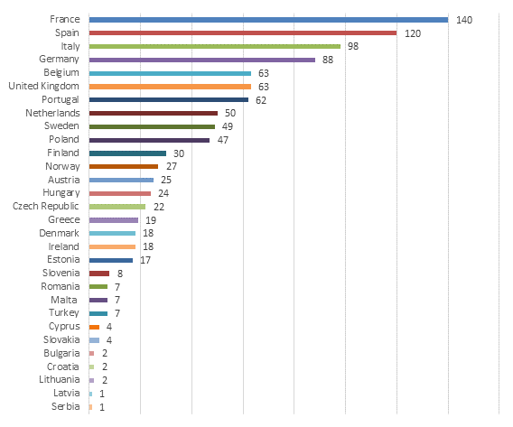
« Underrepresented »
Hits in the Catalogue (28/10/2022):
Art – 2
Chemistry – 20
Economic Sciences – 16
Education – 1
Environmental and Geoscience – 46
HIS – 2
Information science and engineering – 57
IT – 6
Etc.
Notes:
Study whether your field is already covered and by which institutions
Select partnerships that make sense (jointness + excellence)
Motivate your choices.

Slide 21
EMDM Set-up
One beneficiary mobilising a group of other HEIs (aiming at an EMJM consortium)
Fixed duration of 15 months
EU Grant: single lump sum contribution of 55.000 Euros (for costs linked to the activities necessary to set up the new joint master programme)

Slide 22
Expected outcomes of an EMDM
Joint programme design and joint procedures
Joint administrative and financial management
Common services offered to students
Joint promotion and dissemination
A draft joint Partnership and Student Agreement
A joint degree policy and launch of accreditation process
+ explore opportunities offered by the European Approach for Quality Assurance of Joint Programmes (if national legislation allows)

Slide 23
« Tips and tricks »
AWARD CRITERIA
No 100% match between application form and EMDM: see also FTOP - FAQs
Make a convincing case for the need for your project, but also for the feasibility of your future joint programme by month 15

Slide 24
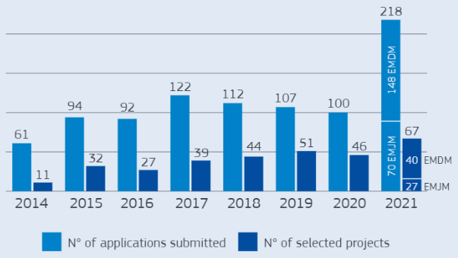
New programme stats
Results of the first call under 2021-2027 MFF; https://op.europa.eu/s/xaS9
Notes:
Second call: 190 proposals
30 EMJMs, 58 proposals, 2 by NL coordinators (EMLE, erasmus University Rotterdam, Red Global, Rijks Universiteit Groningen)
60 EMDMs, 122 proposals, 1 by NL (Hogeschool Utrecht)

Slide 25
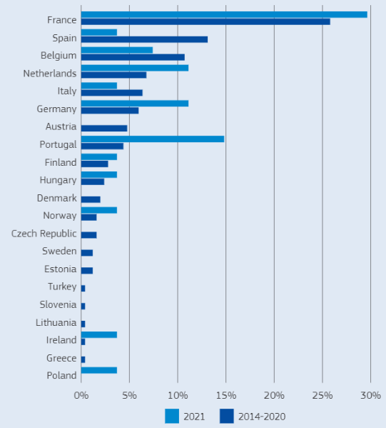
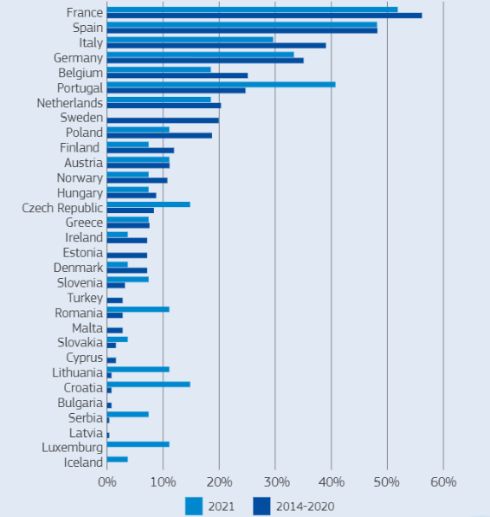
% of coordinated EMJM / EMJMDs per Country
% of selected projects involving Programme Country as full partner or coordinator
Notes:
Plaats 5 ; plaats 8

Slide 26
How to apply - eForm
Funding opportunities for 2021-2027 and information on how to apply are announced on the European Commission’s Funding & Tender Opportunities Portal:
https://ec.europa.eu/info/funding-tenders/opportunities/portal/screen/home
Applications to be submitted using an eForm with attachments;
Call publication: Mid November 2022 tbc
Call deadline: early February 2023 tbc

Slide 27
Information about the programme
Erasmus+ Programme guide 2023: under preparation
Erasmus+ Programme Guide | Erasmus+ (europa.eu) (version from Jan. 2022)
Erasmus Mundus calls for proposals 2023 on Funding & tender opportunities portal https://ec.europa.eu/info/funding-tenders/opportunities/portal/screen/home
How to get a grant (europa.eu) - General info for applicants on EACEA website

Slide 28
Other information sources
Erasmus Mundus, analysis of the results of the first 2021-2027 call (joint masters and design measures)
Statistical factsheets on the achievements of the Erasmus Mundus Joint Master Degrees (2014-2020)
Erasmus+ Factsheets
Report 'Implementing Joint Degrees in the Erasmus Mundus action of the Erasmus+ programme'
EMJMD catalogue
EMJMD Cluster meeting 2018: European Approach for Quality Assurance of Joint Programmes
and Follow-up event 2019 "Implementing the European Approach for Quality Assurance for EMJMDs
Erasmus Mundus Joint Master Degrees - The story so far
Sustainability of Erasmus Mundus Master Courses - Best practice guide
Erasmus+ Project result platform

Slide 29
Thank you
Please contact us at: EACEA-EPLUS-ERASMUS-MUNDUS@ec.europa.eu
© European Union 2021
Unless otherwise noted the reuse of this presentation is authorised under the CC BY 4.0 license. For any use or reproduction of elements that are not owned by the EU, permission may need to be sought directly from the respective right holders.
Slide 1 Image, source: © European Union, 2021 (CC BY-NC-ND 4.0) — iStockphoto.com; Slide 4-5-6-10-11-14-15-17-18-20-22-24-27-29-32-33-39-40-41 Pictograms, source: Flaticon.com; Slide 20 Photo, source: EACEA R1 Communication, European Commission & Slide 41 Photo, source: Designed by macrovector / Freepik.

